Slide 1
Recurrent Neural Networks: Architecture and Variants
Dr. T. Hitendra Sarma
Associate Professor, Vasavi College of Engineering, Hyderabad
Chair, IEEE Science, Technology, Engineering and Mathematics (STEM), HYD Section(2021-22)
Past Chair, IEEE CIS/GRSS Chapter, Hyderabad Section (2018-20)

Slide 2
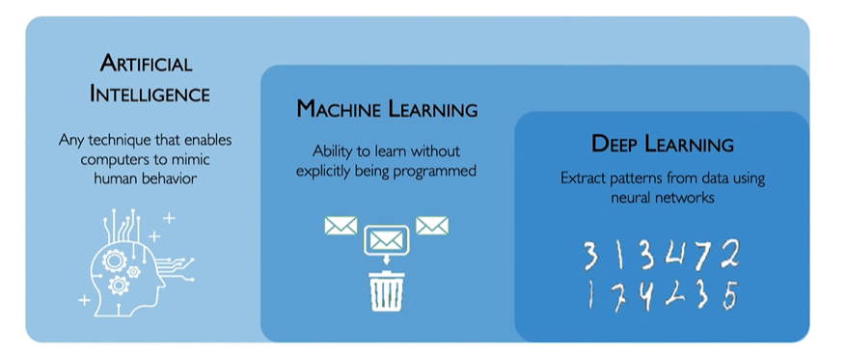
Deep Learning?

Slide 3
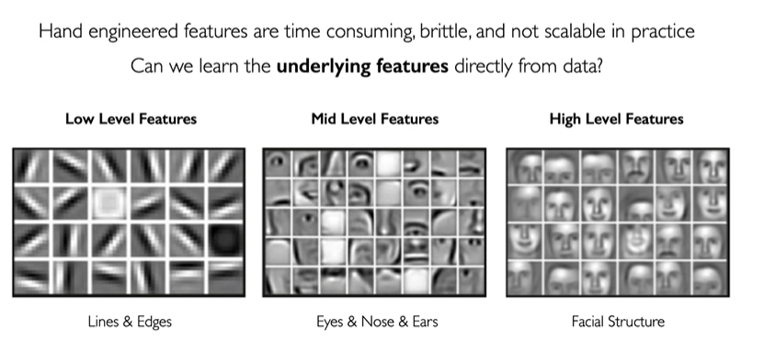
From ML to DL

Slide 4
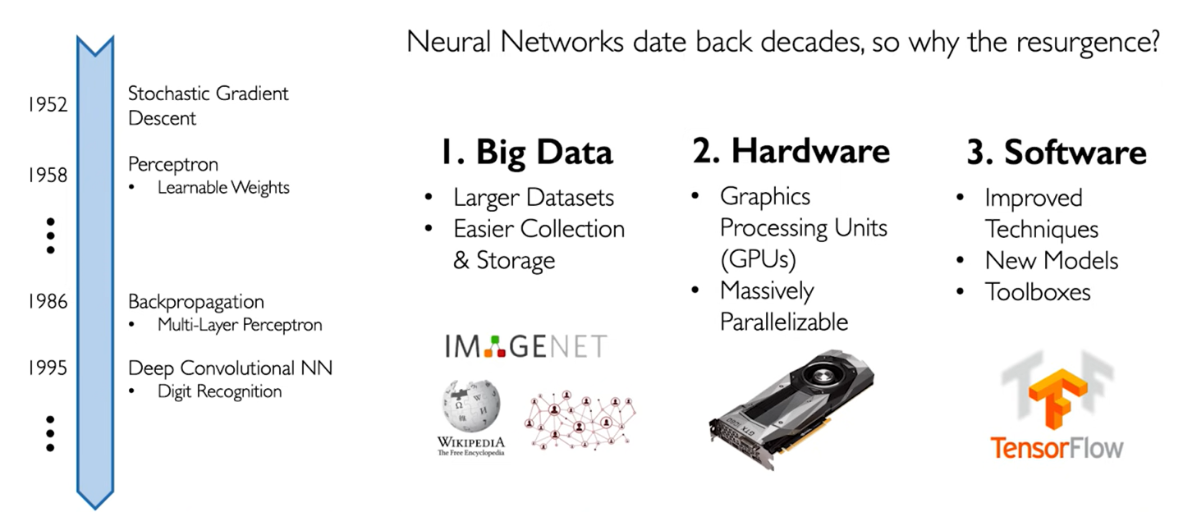
DL becoming more ubiquitous in recent times

Slide 5
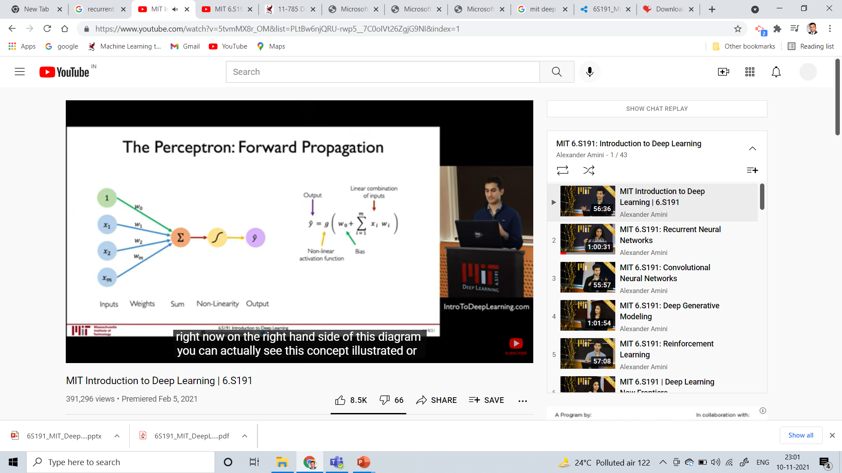

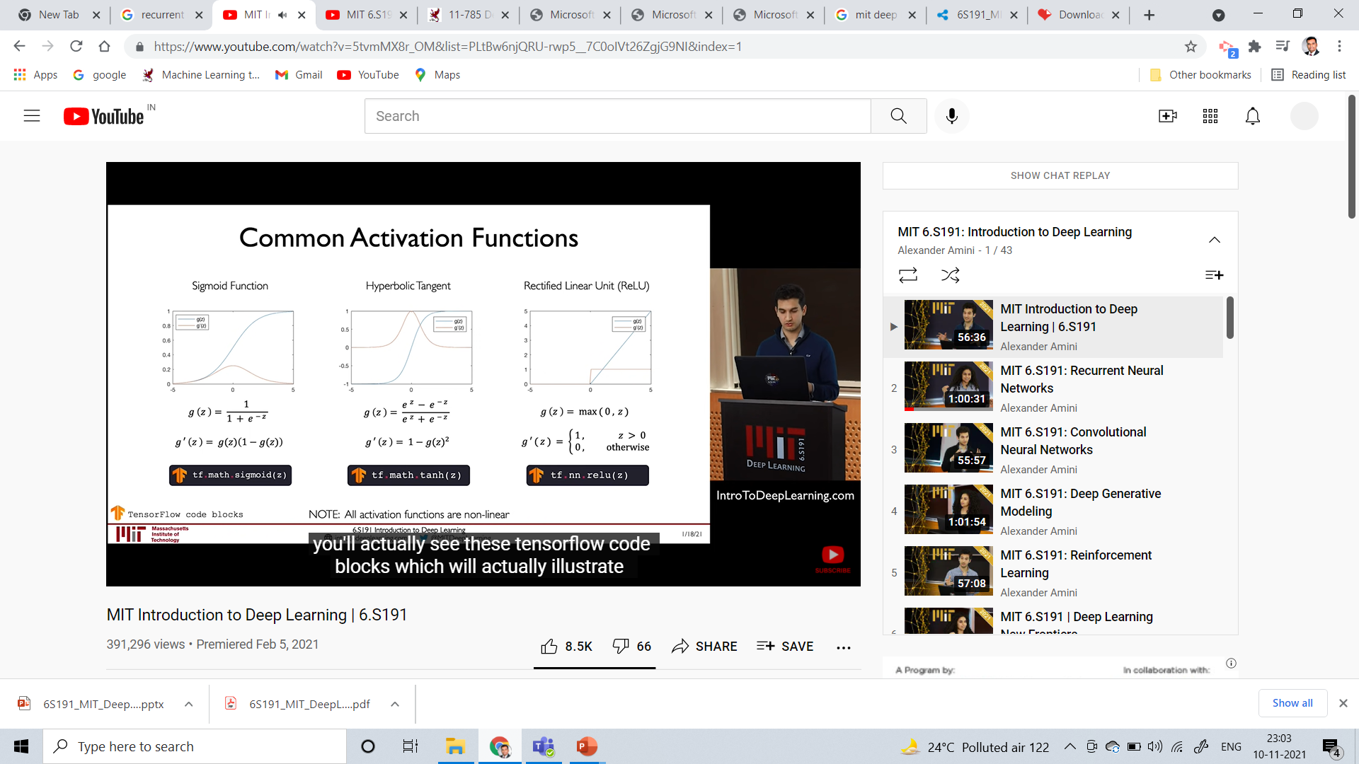
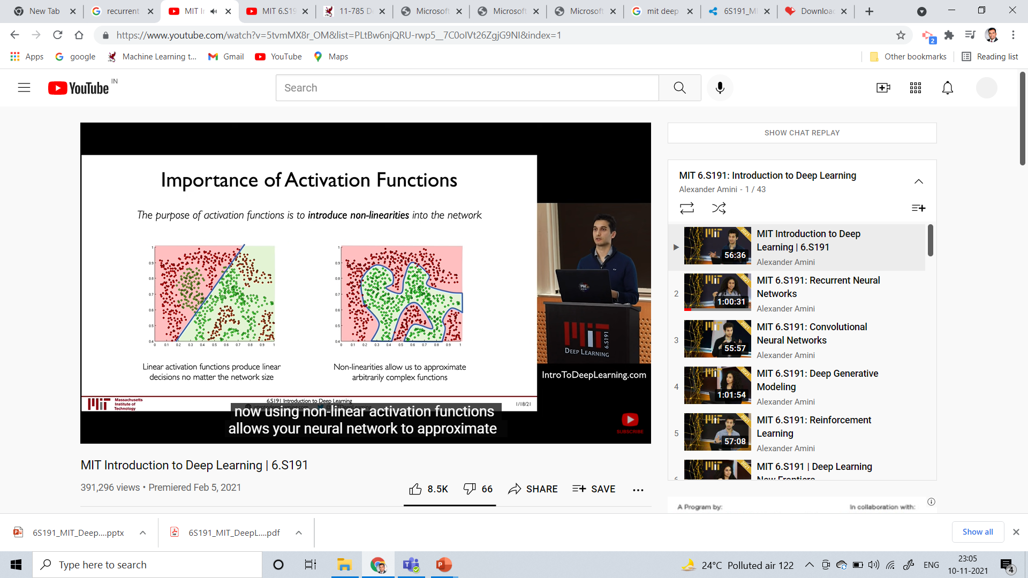
Perceptron

Slide 6
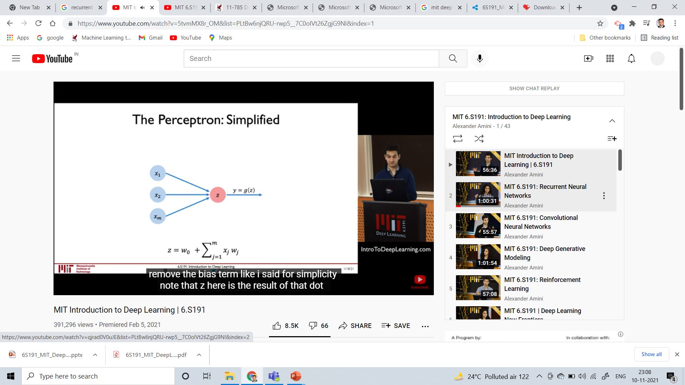
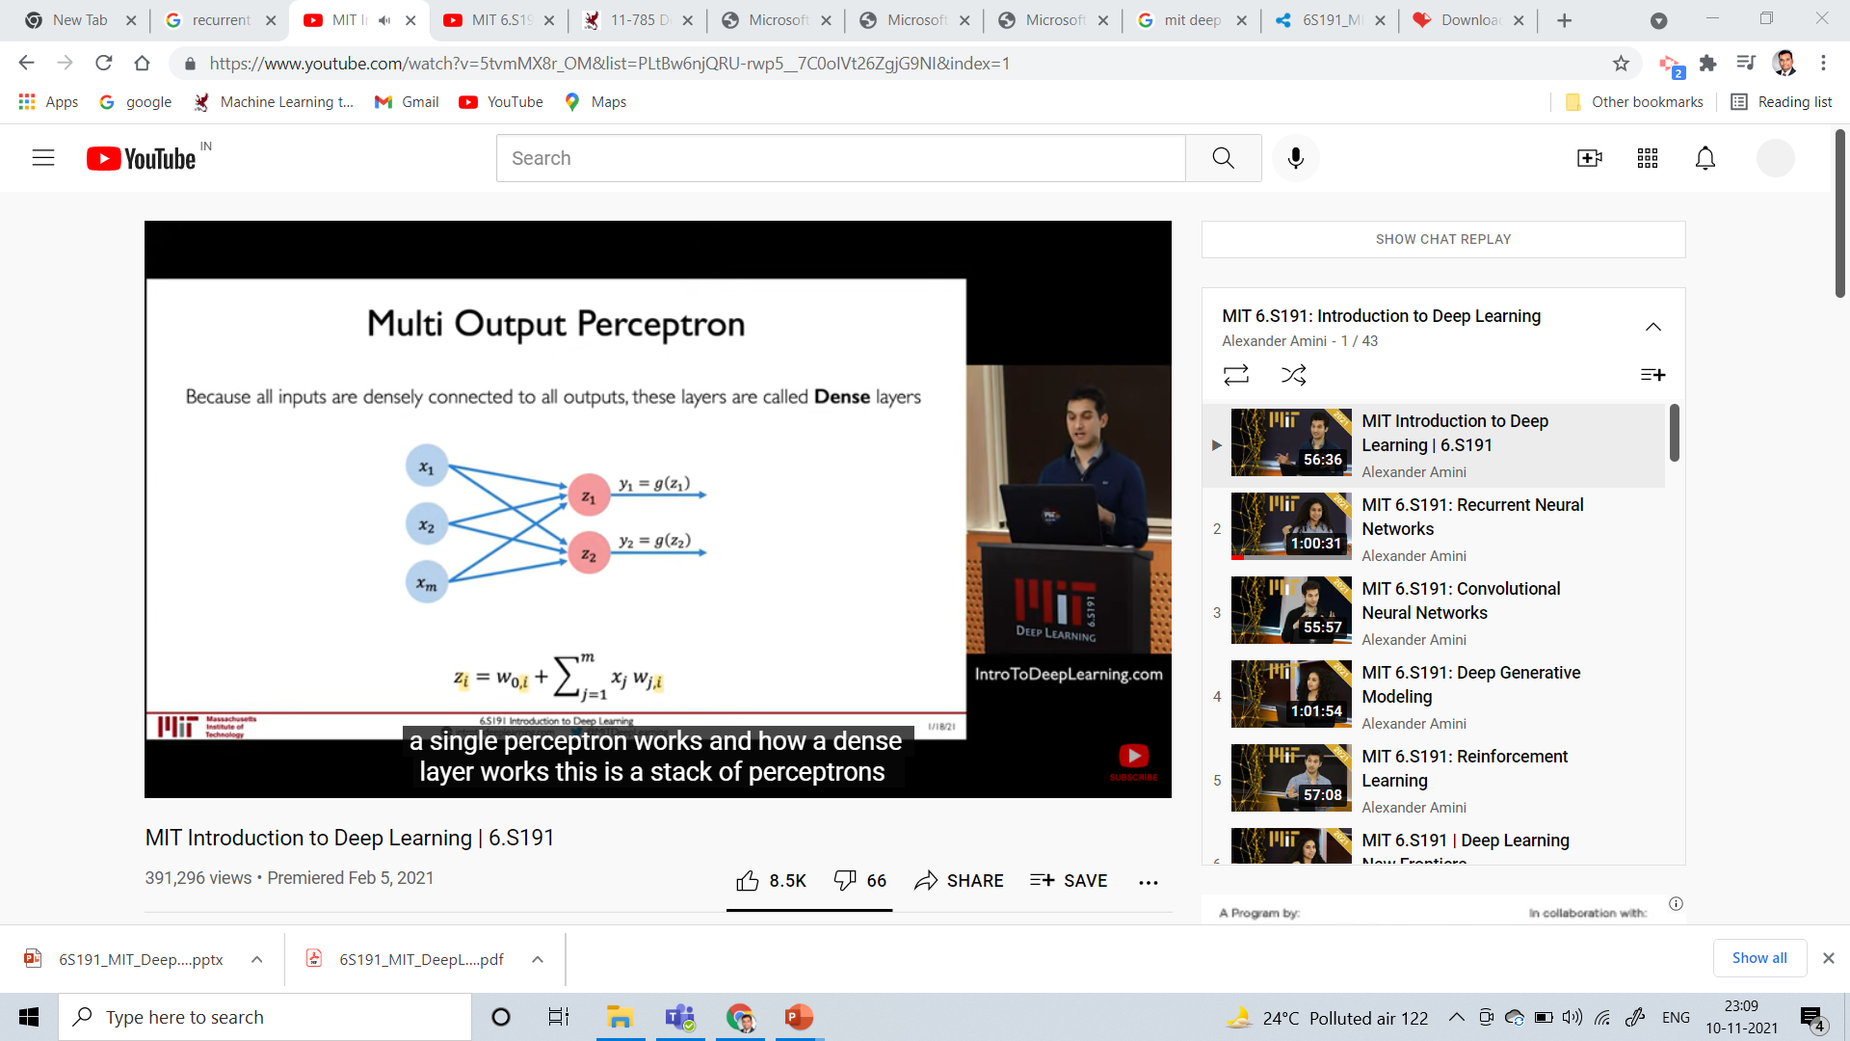
Multi output perceptron

Slide 7

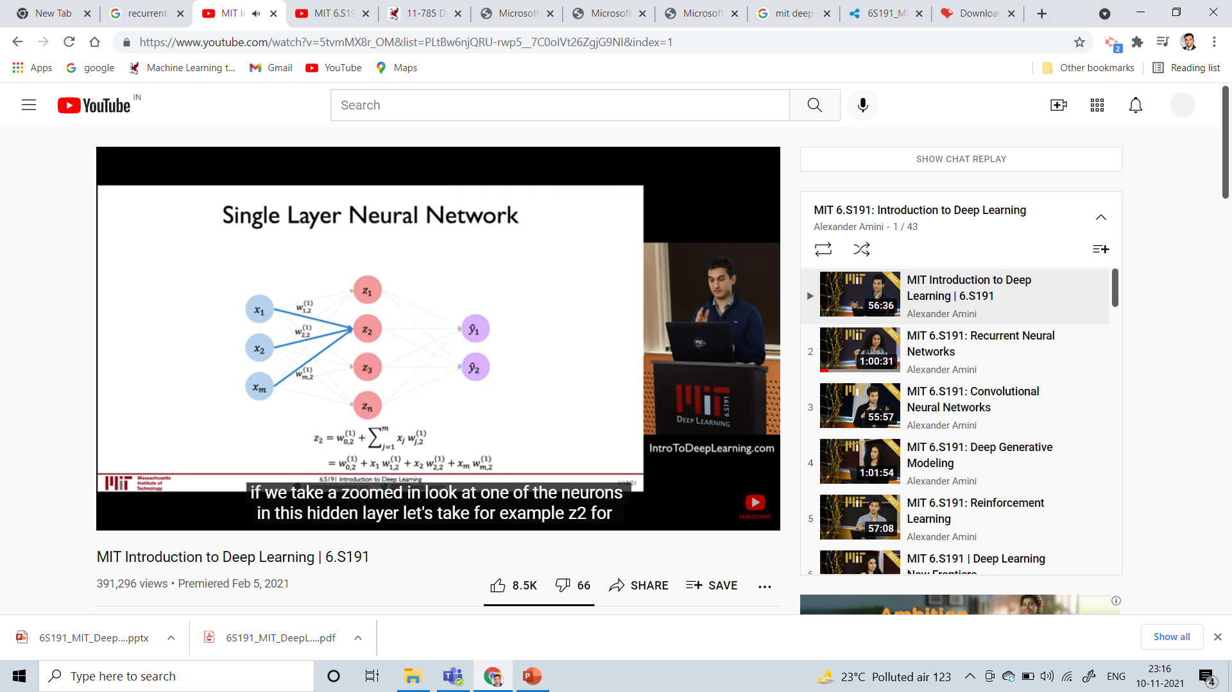
Single Layer Neural Network

Slide 8
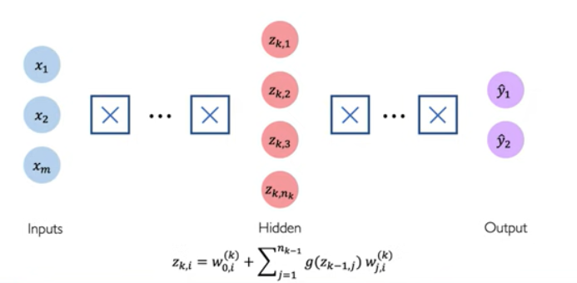
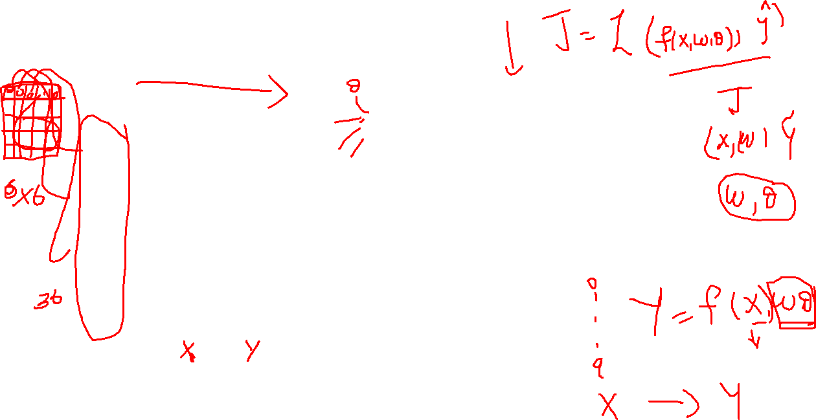
Deep Neural Network

Slide 9
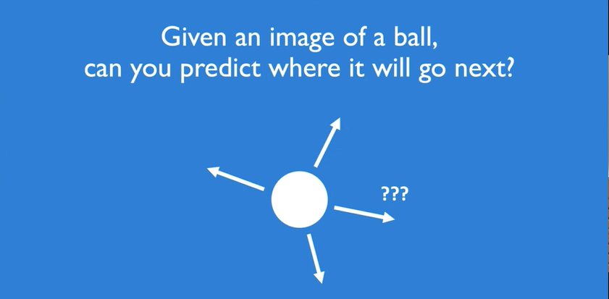
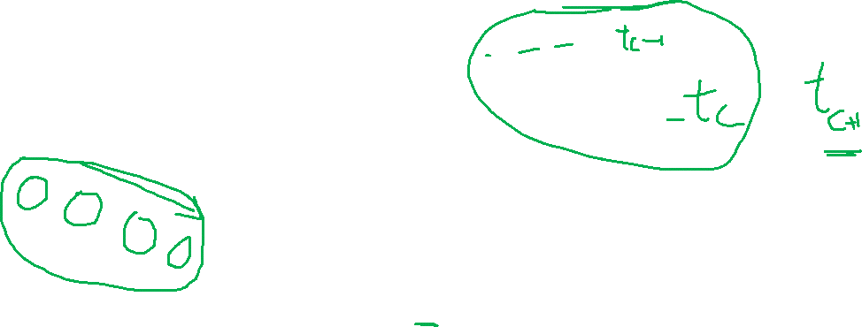
Motivation of Sequential Processing
Source: MIT 6.S191: Introduction to Deep Learning

Slide 10
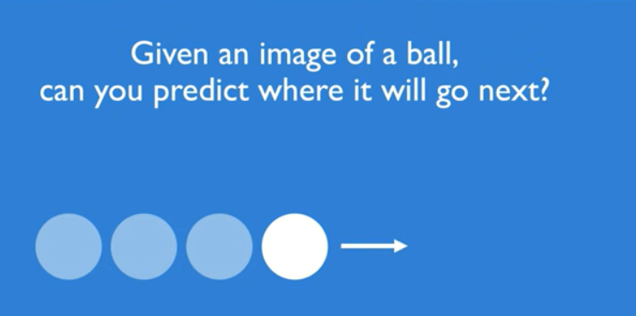
Motivation of Sequential Processing
Source: MIT 6.S191: Introduction to Deep Learning

Slide 11
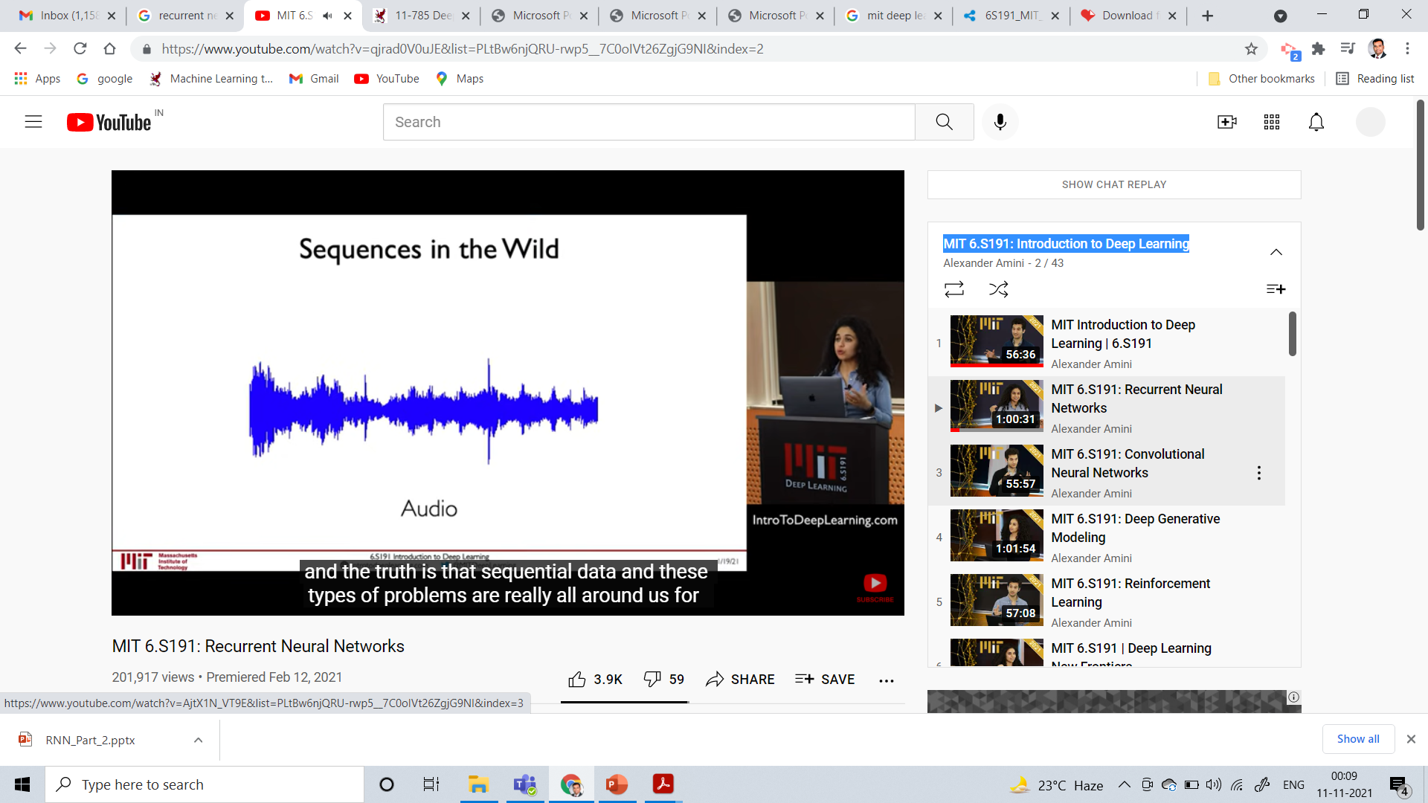
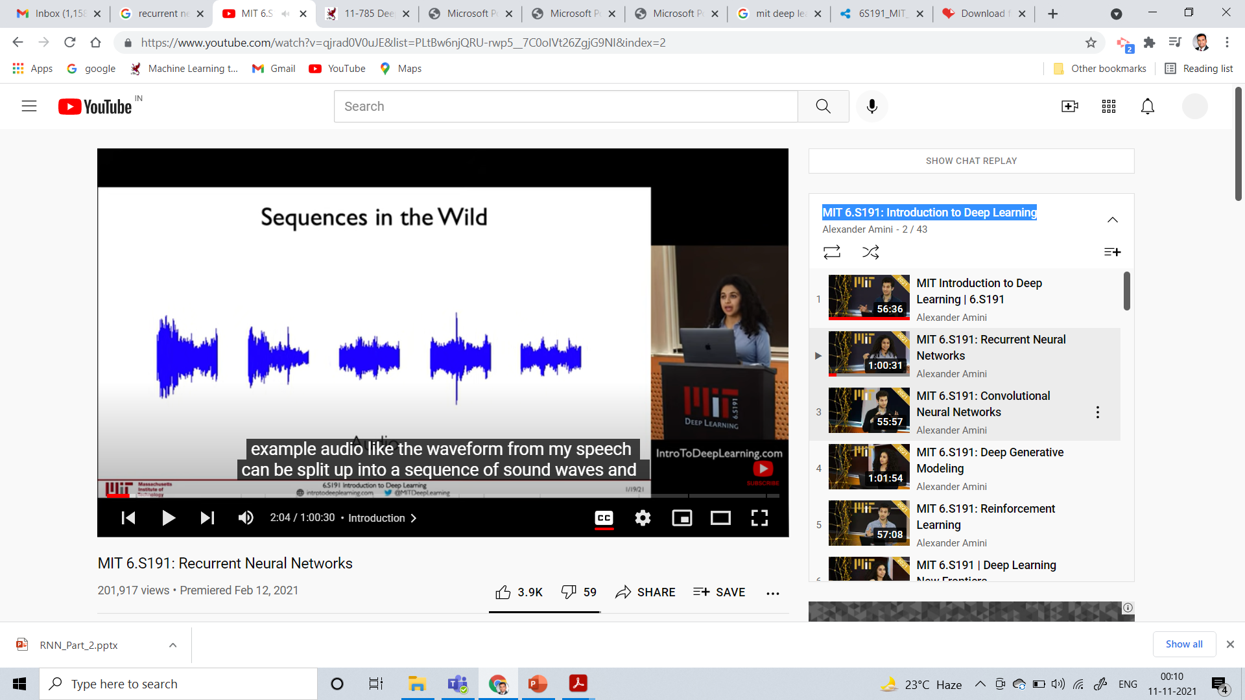
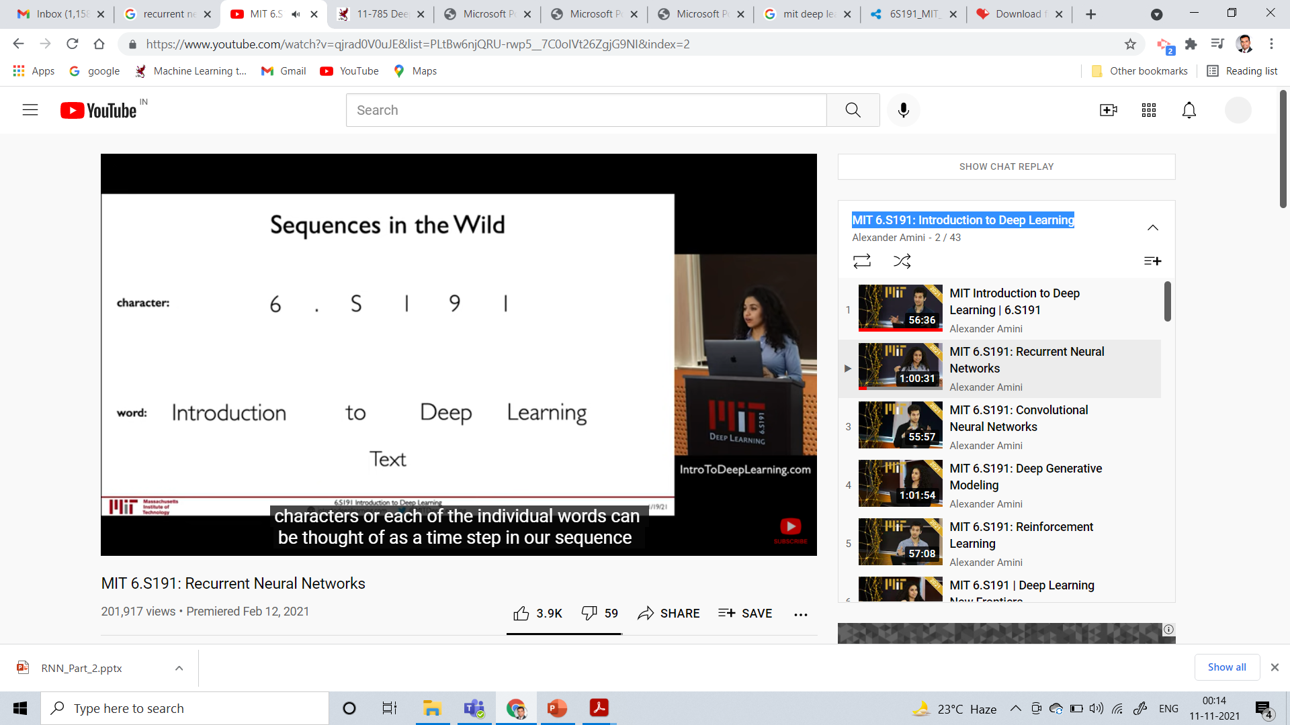
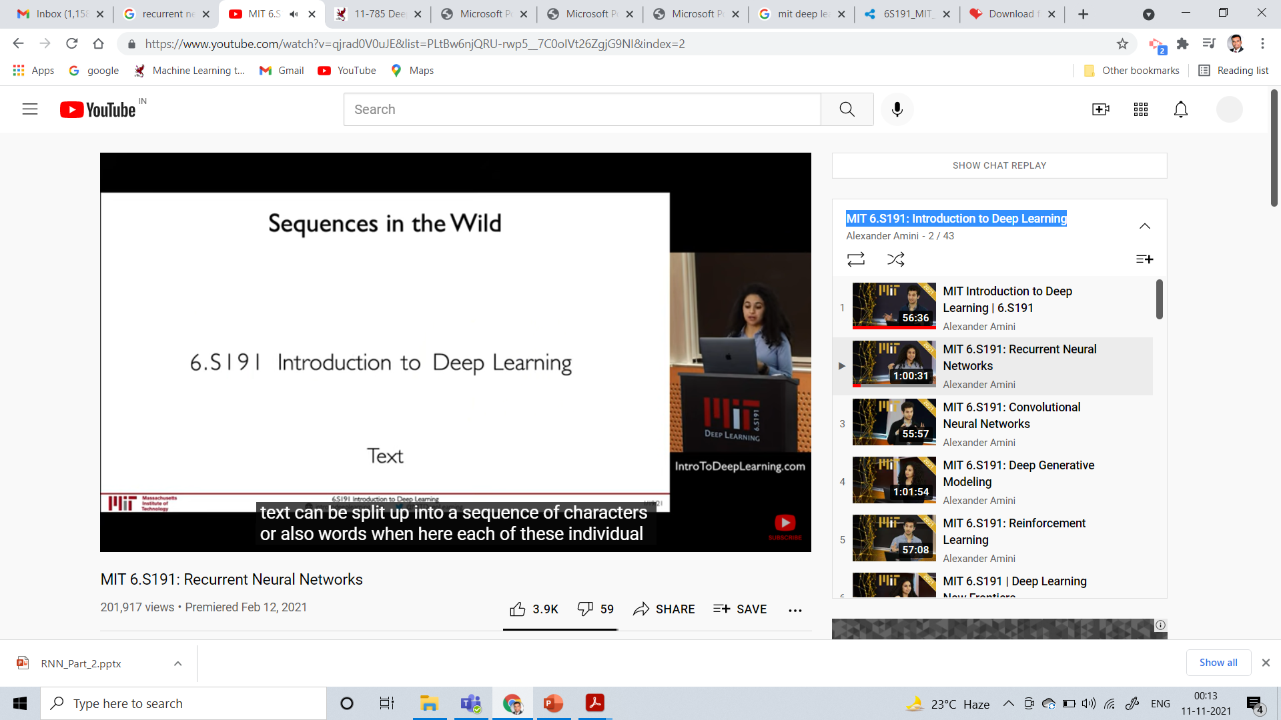
Motivation of Sequential Processing
Source: MIT 6.S191: Introduction to Deep Learning

Slide 12
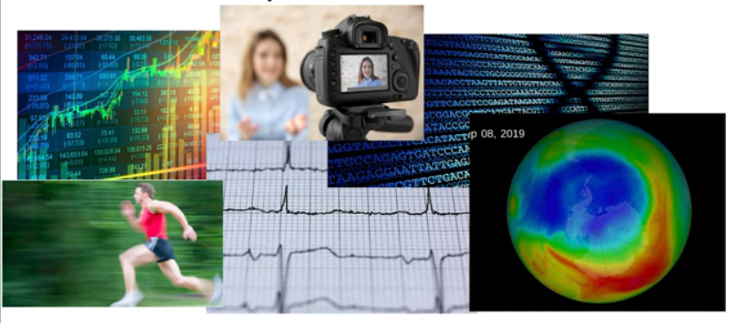
Some other motivating examples

Slide 13
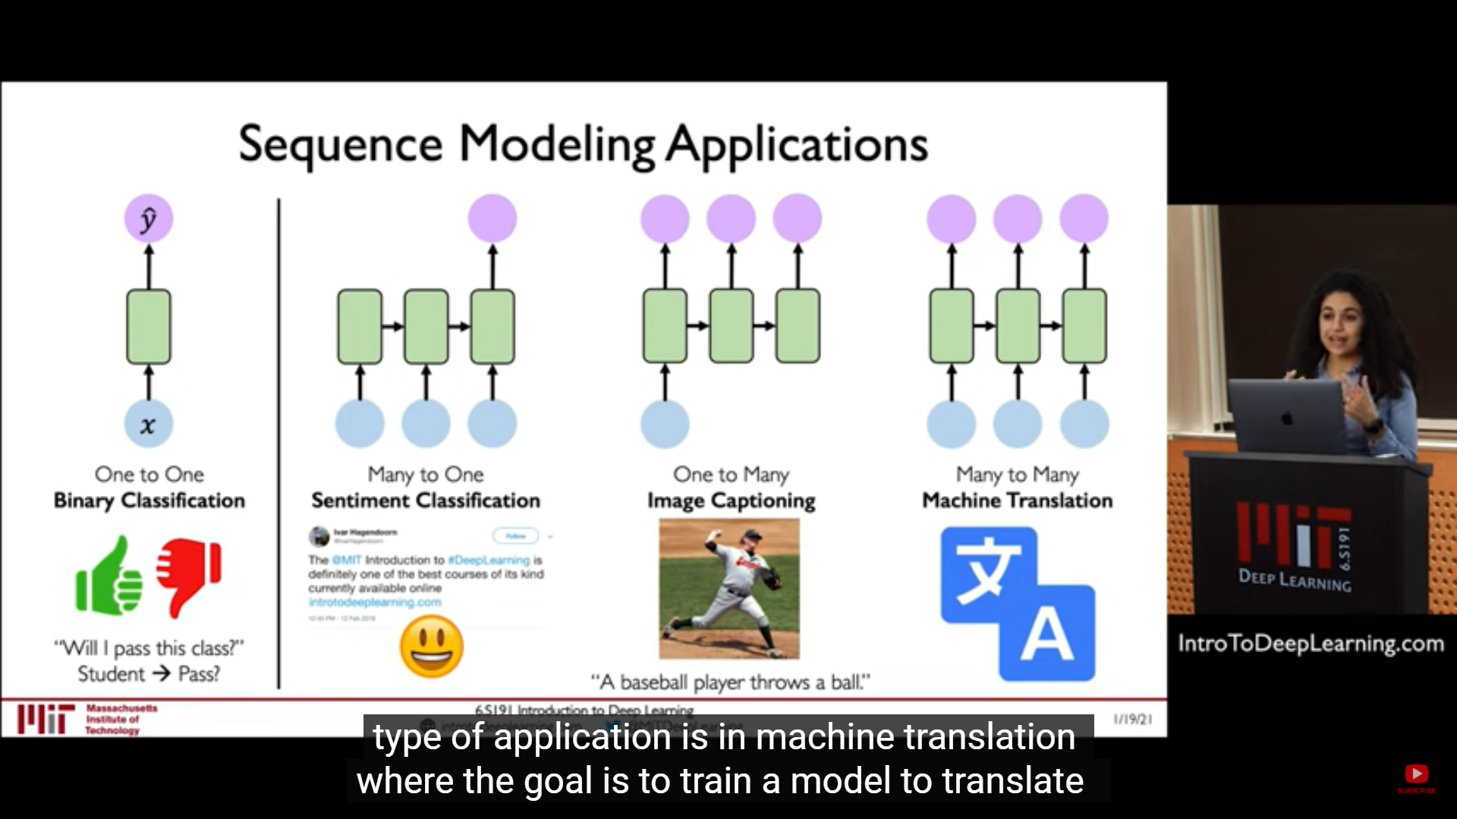
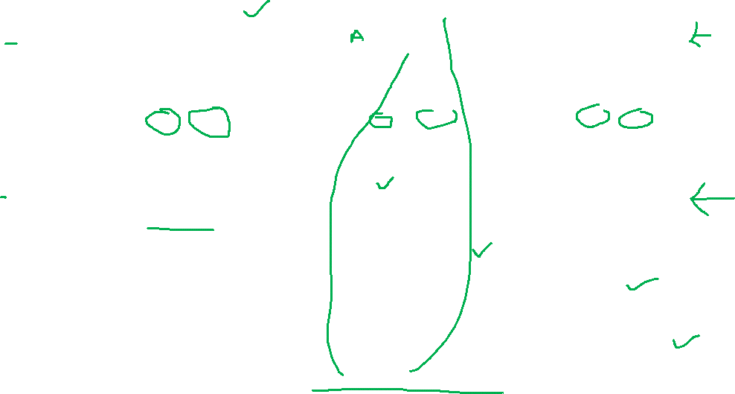
Some use cases

Slide 14
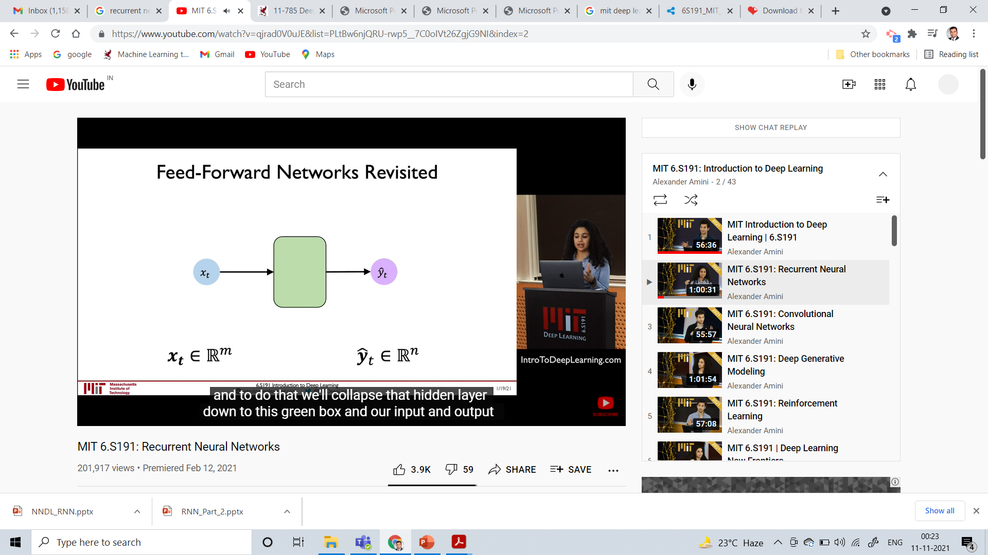
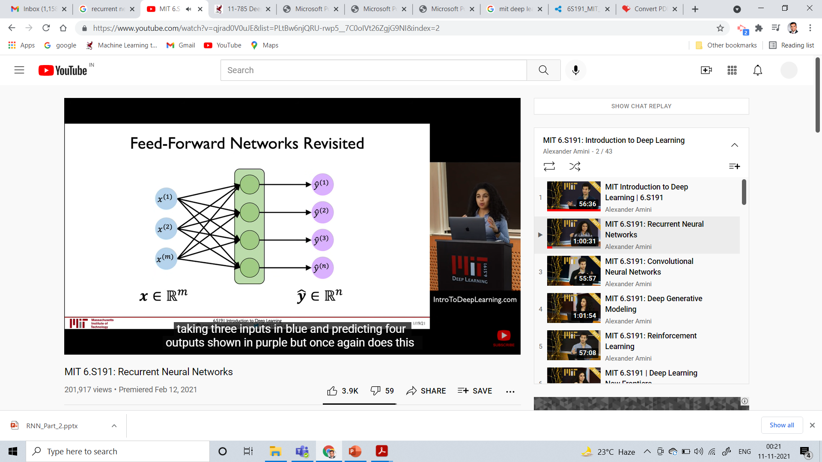
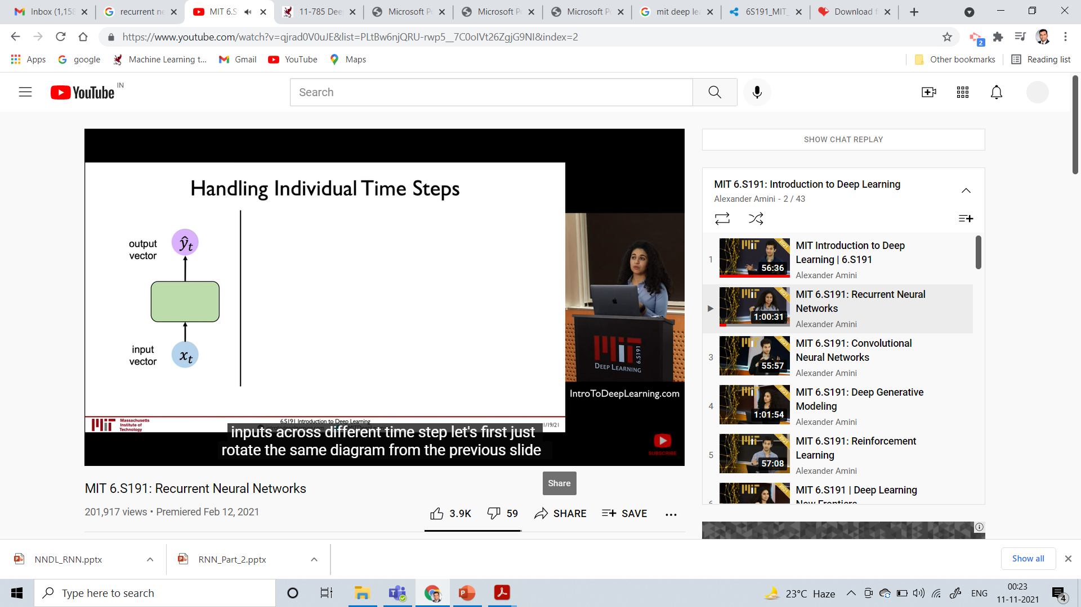
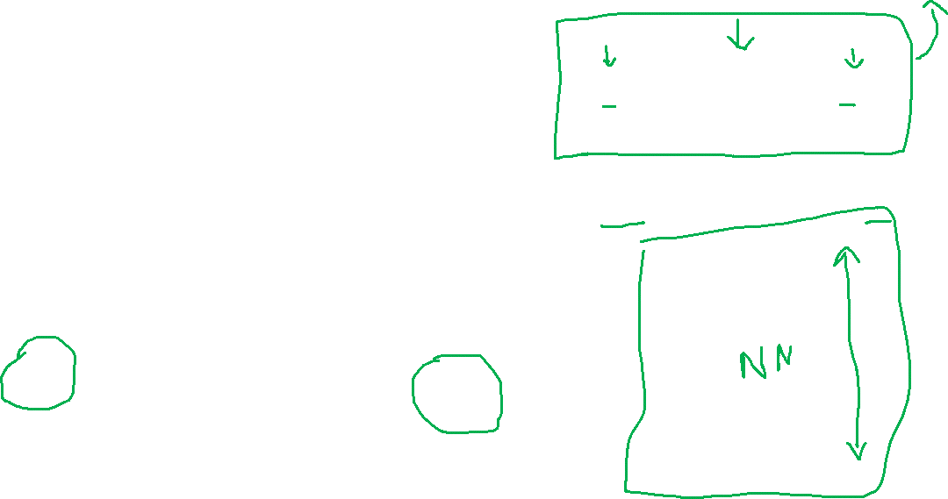
Quick recap of Feed-Forward Neural Network

Slide 15
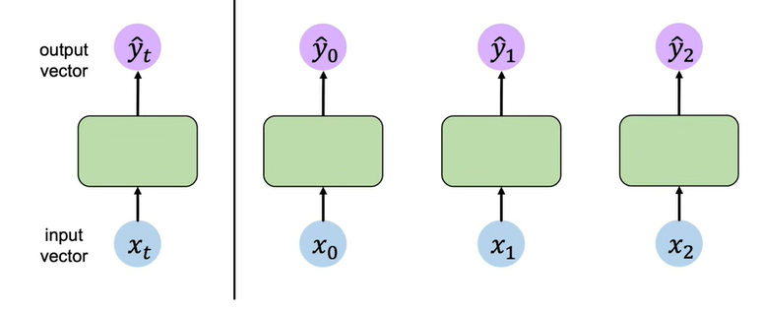
With different time stamps
How to capture inter dependence?

Slide 16
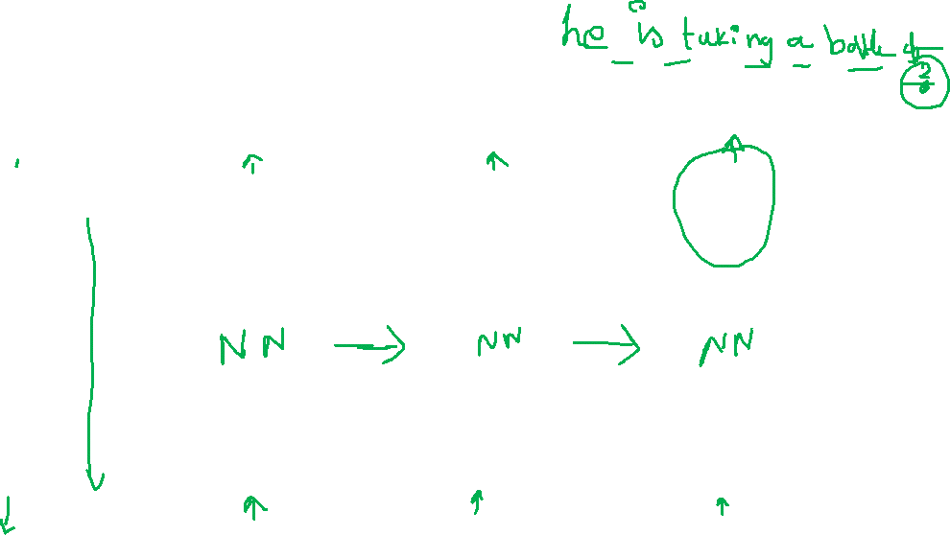
With different time stamps

Slide 17
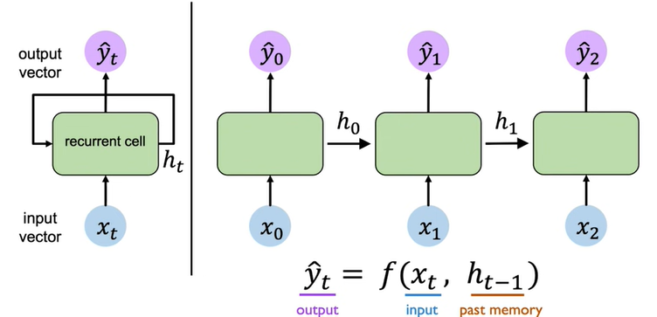
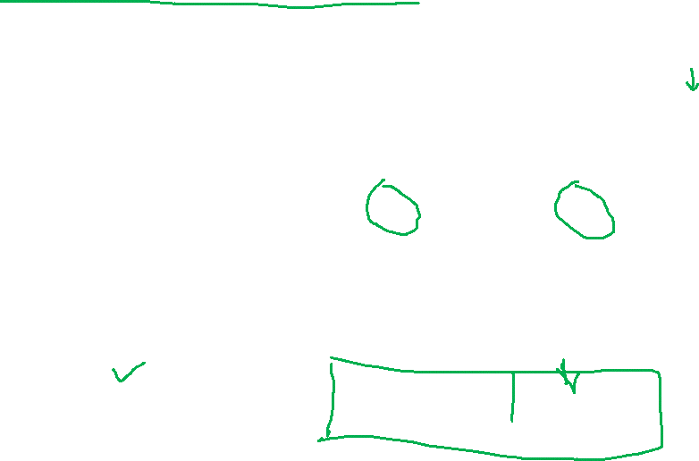
Neurons with Recurrence

Slide 18


Recurrent Neural Networks (RNNs)

Slide 19

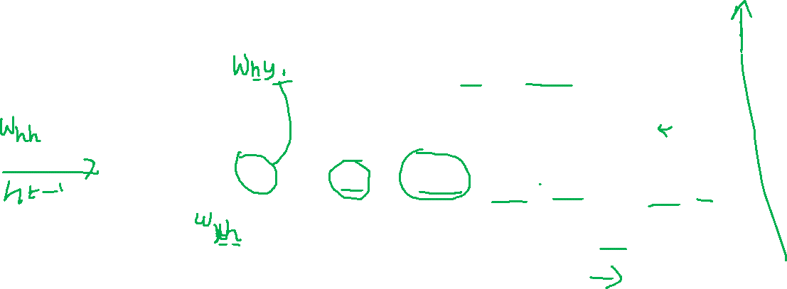
RNN State Update and Output

Slide 20
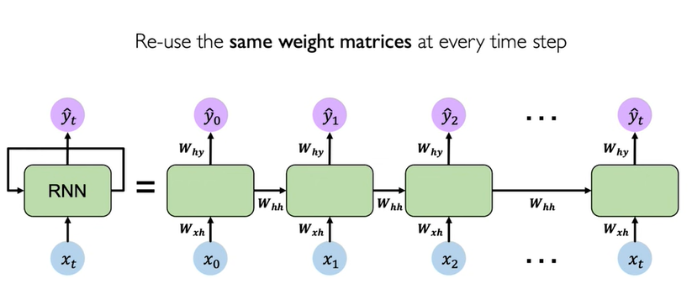
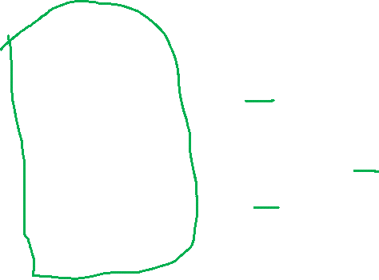
RNNs: Computational Graph Across Time

Slide 21
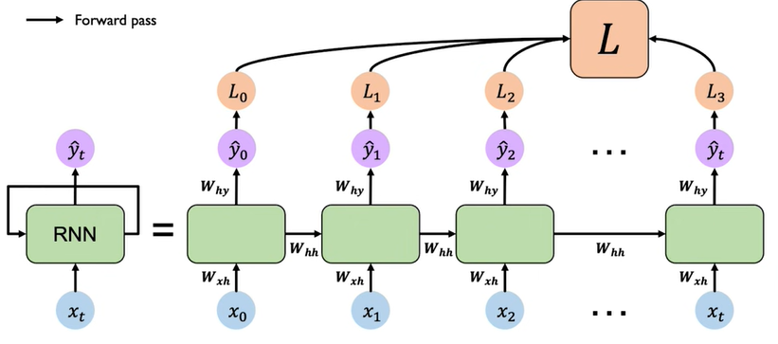
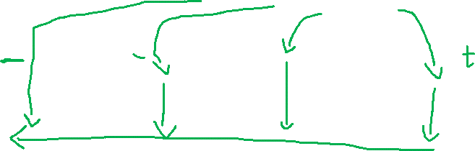
RNNs: Computational Graph Across Time

Slide 22
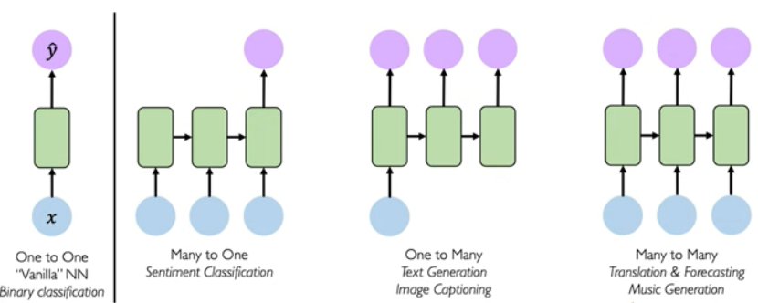
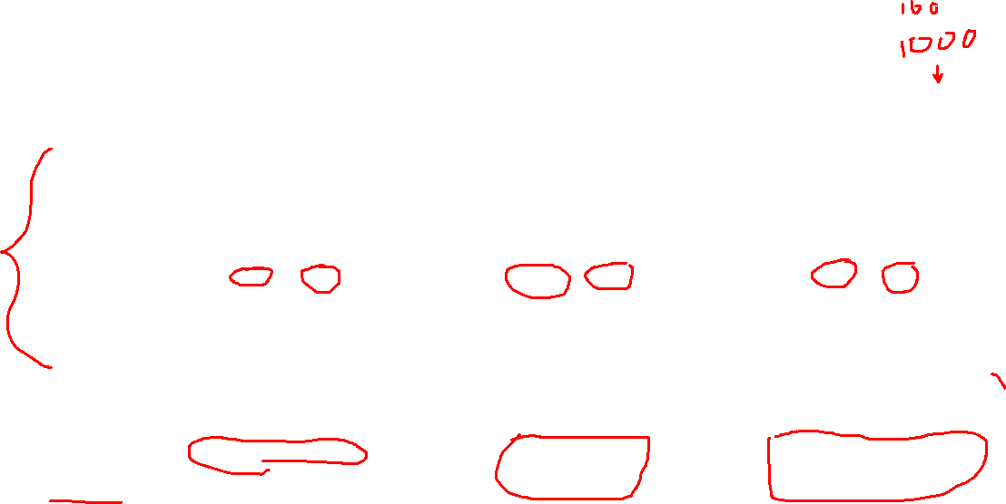
Some interesting applications of RNNs

Slide 23
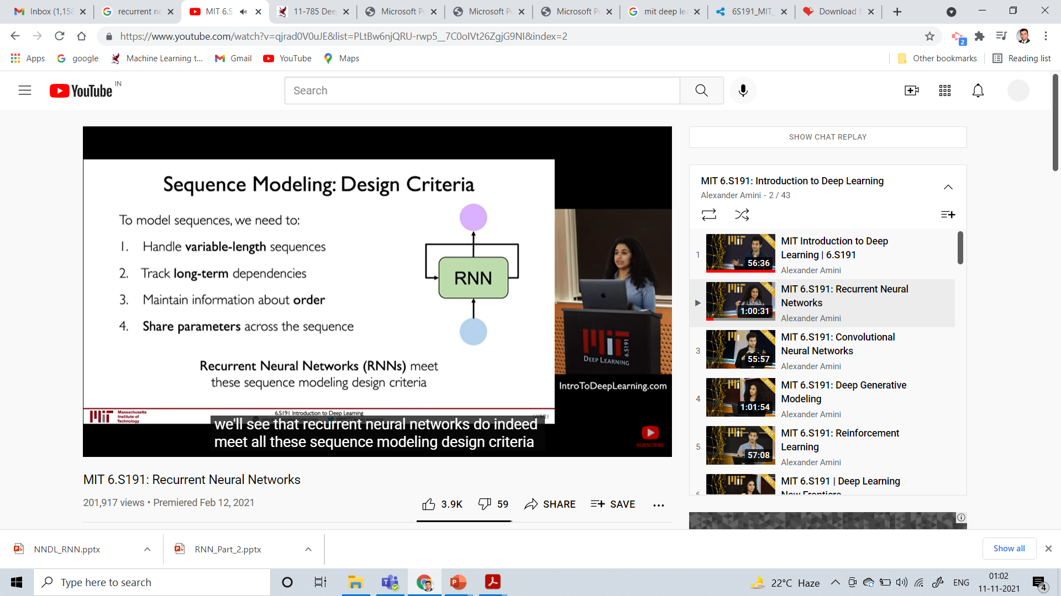
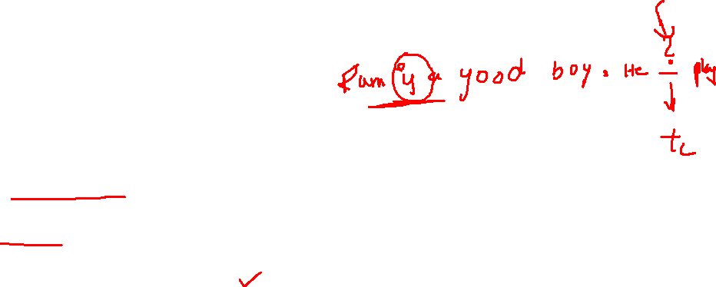
Sequence Modeling: Design Criteria

Slide 24
Summary

Slide 25
Recurrent Neural Network
RNN
x
Fei-Fei Li & Justin Johnson & Serena Yeung
Fei-Fei Li & Justin Johnson & Serena Yeung Lecture 10 - May 4, 2017

Slide 26
Recurrent Neural Network
y
usually want to predict a vector at some time steps
RNN
x
Fei-Fei Li & Justin Johnson & Serena Yeung
Fei-Fei Li & Justin Johnson & Serena Yeung Lecture 10 - May 4, 2017

Slide 27
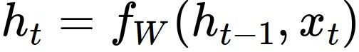
Recurrent Neural Network
We can process a sequence of vectors x by applying a recurrence formula at every time step:
y
RNN
new state old state input vector at
some time step
x
some function
with parameters W
Fei-Fei Li & Justin Johnson & Serena Yeung
Fei-Fei Li & Justin Johnson & Serena Yeung Lecture 10 - May 4, 2017

Slide 28
Recurrent Neural Network
We can process a sequence of vectors x by applying a recurrence formula at every time step:
y
RNN
x
Notice: the same function and the same set of parameters are used at every time step.
Fei-Fei Li & Justin Johnson & Serena Yeung
Fei-Fei Li & Justin Johnson & Serena Yeung Lecture 10 - May 4, 2017

Slide 29
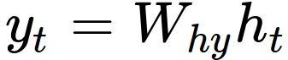
(Vanilla) Recurrent Neural Network
The state consists of a single “hidden” vector h:
y
RNN
x
Fei-Fei Li & Justin Johnson & Serena Yeung
Fei-Fei Li & Justin Johnson & Serena Yeung Lecture 10 - May 4, 2017

Slide 30
RNN: Computational Graph
h₀
h₁
f_{W}
x₁
Fei-Fei Li & Justin Johnson & Serena Yeung
Fei-Fei Li & Justin Johnson & Serena Yeung Lecture 10 - May 4, 2017

Slide 31
RNN: Computational Graph
h₀
h₁
h₂
f_{W}
f_{W}
x₁
x₂
Fei-Fei Li & Justin Johnson & Serena Yeung
Fei-Fei Li & Justin Johnson & Serena Yeung Lecture 10 - May 4, 2017

Slide 32
RNN: Computational Graph
h₀
h₁
h₂
h₃
…
h_{T}
f_{W}
f_{W}
f_{W}
x₁
x₂
x₃
Fei-Fei Li & Justin Johnson & Serena Yeung
Fei-Fei Li & Justin Johnson & Serena Yeung Lecture 10 - May 4, 2017

Slide 33
RNN: Computational Graph
Re-use the same weight matrix at every time-step
h₂
h₃
…
h_{T}
h₀
f_{W}
h₁
f_{W}
f_{W}
x₁
x₂
x₃
W
Fei-Fei Li & Justin Johnson & Serena Yeung

Slide 34
RNN: Computational Graph: Many to Many
y₁
y₂
y₃
y_{T}
h₂
h₃
…
h_{T}
h₀
f_{W}
h₁
f_{W}
f_{W}
x₁
x₂
x₃
W
Fei-Fei Li & Justin Johnson & Serena Yeung

Slide 35
RNN: Computational Graph: Many to Many
y₁
y₂
y₃
y_{T}
L₁
L₂
L₃
L_{T}
h₂
h₃
…
h_{T}
h₀
f_{W}
h₁
f_{W}
f_{W}
x₁
x₂
x₃
W
Fei-Fei Li & Justin Johnson & Serena Yeung
Fei-Fei Li & Justin Johnson & Serena Yeung Lecture 10 - May 4, 2017

Slide 36
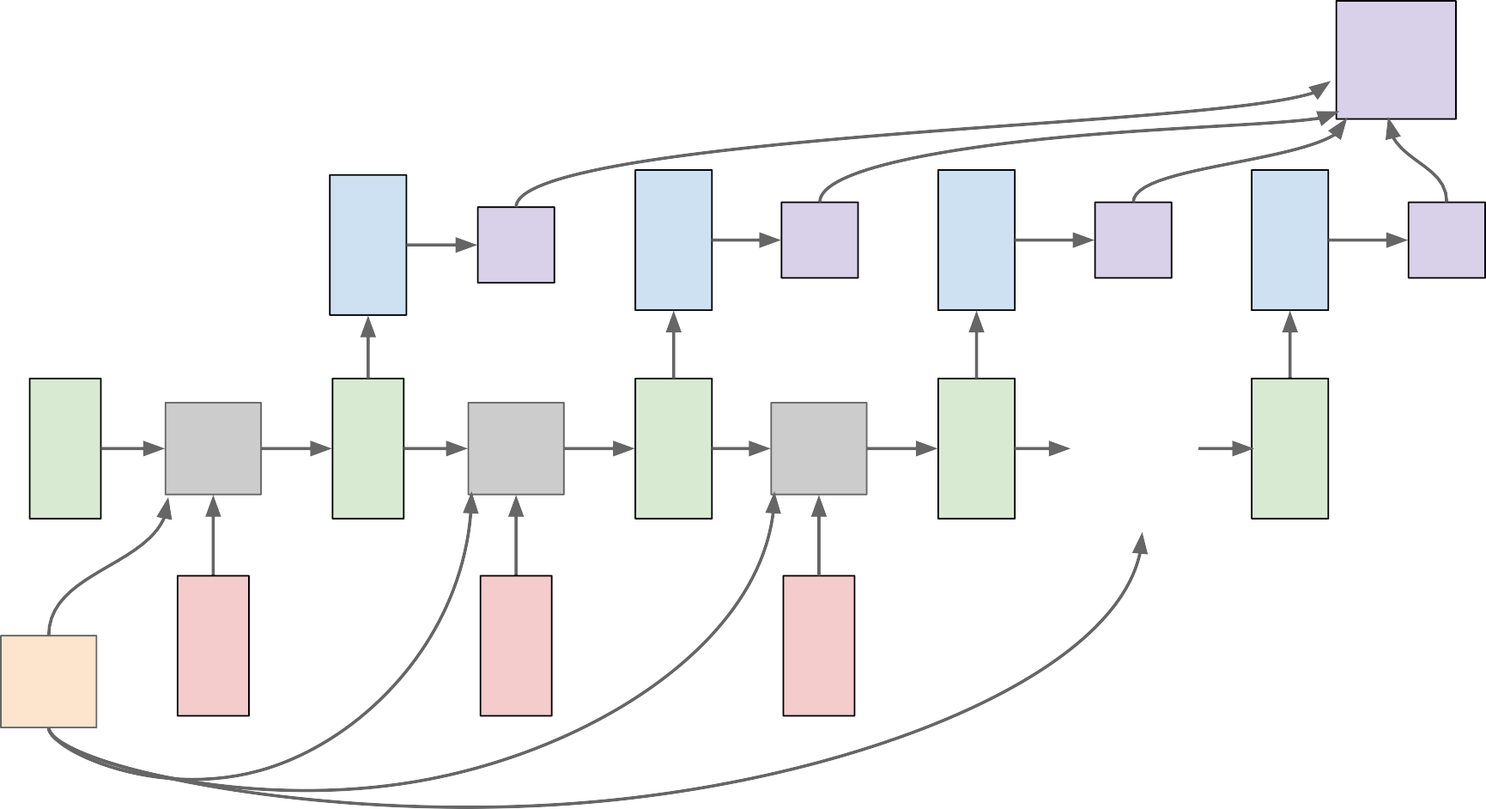

RNN: Computational Graph: Many to Many
L
f_{W} | y₁ h₁ | L₁ f_{W} | y₂ h₂ | L₂ f_{W} | y₃ h₃ | L₃ … | y_{T} h_{T} | L_{T}
x₁ |  | x₂ |  | x₃
h₀
W
Fei-Fei Li & Justin Johnson & Serena Yeung

Slide 37
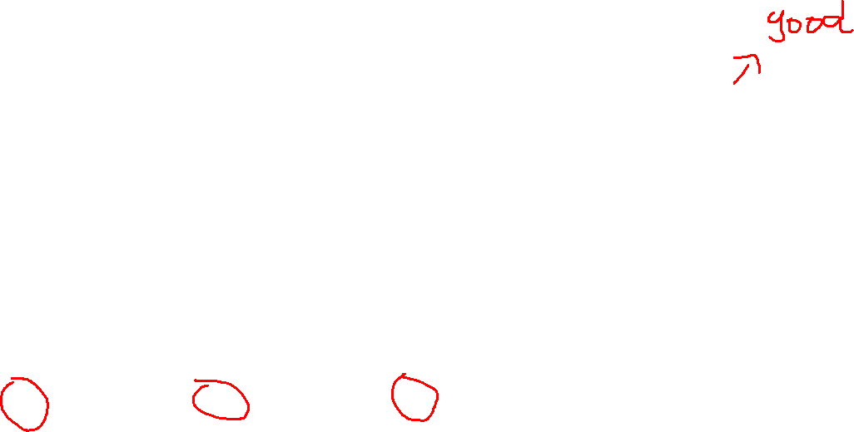
RNN: Computational Graph: Many to One
y
h₂
h₃
…
h_{T}
h₀
f_{W}
h₁
f_{W}
f_{W}
x₁
x₂
x₃
W
Fei-Fei Li & Justin Johnson & Serena Yeung
Fei-Fei Li & Justin Johnson & Serena Yeung Lecture 10 - May 4, 2017

Slide 38

RNN: Computational Graph: One to Many
y₃
y₃
y₃
y_{T}
h₂
h₃
…
h_{T}
h₀
f_{W}
h₁
f_{W}
f_{W}
x
W
Fei-Fei Li & Justin Johnson & Serena Yeung
Fei-Fei Li & Justin Johnson & Serena Yeung Lecture 10 - May 4, 2017

Slide 39

Sequence to Sequence: Many-to-one + one-to-many
Many to one: Encode input sequence in a single vector
h
0
f_{W}
h
1
f_{W}
h
2
f_{W}
h
3
…
h
T
x
1
x
2
x
3
W
1
Fei-Fei Li & Justin Johnson & Serena Yeung
Fei-Fei Li & Justin Johnson & Serena Yeung Lecture 10 - May 4, 2017

Slide 40
Sequence to Sequence: Many-to-one + one-to-many
One to many: Produce output sequence from single input vector
Many to one: Encode input
sequence in a single vector
y
1
y
2
h
0
f_{W}
h
1
f_{W}
h
2
f_{W}
h
3
…
h
T
h
1
h
2
…
f_{W}
f_{W}
f_{W}
x
1
x
2
x
3
W
W
1
2
Fei-Fei Li & Justin Johnson & Serena Yeung
Fei-Fei Li & Justin Johnson & Serena Yeung Lecture 10 - May 4, 2017

Slide 41
CNNs Vs RNNs
Convolutional network is a neural network that is specialized for processing a grid of values X such as an image, whereas a recurrent neural network is a neural network that is specialized for processing a sequence of values x (1) , . . . , x (τ) .
Just as convolutional networks can readily scale to images with large width and height, and some convolutional networks can process images of variable size, recurrent networks can scale to much longer sequences than would be practical for networks without sequence-based specialization.
Most recurrent networks can also process sequences of variable length.

Slide 42
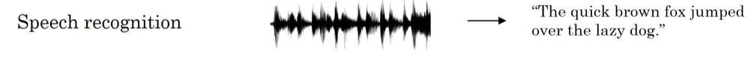
Examples of sequence data
Sequence models: one of the most exciting areas in deep learning.
Models like recurrent neural networks or RNNs have transformed speech recognition, natural language processing and other areas.
In speech recognition you are given an input audio clip X and asked to map it to a text transcript Y.
Both the input and the output here are sequence data, because X is an audio clip and so that plays out over time and Y, the output, is a sequence of words.

Slide 43
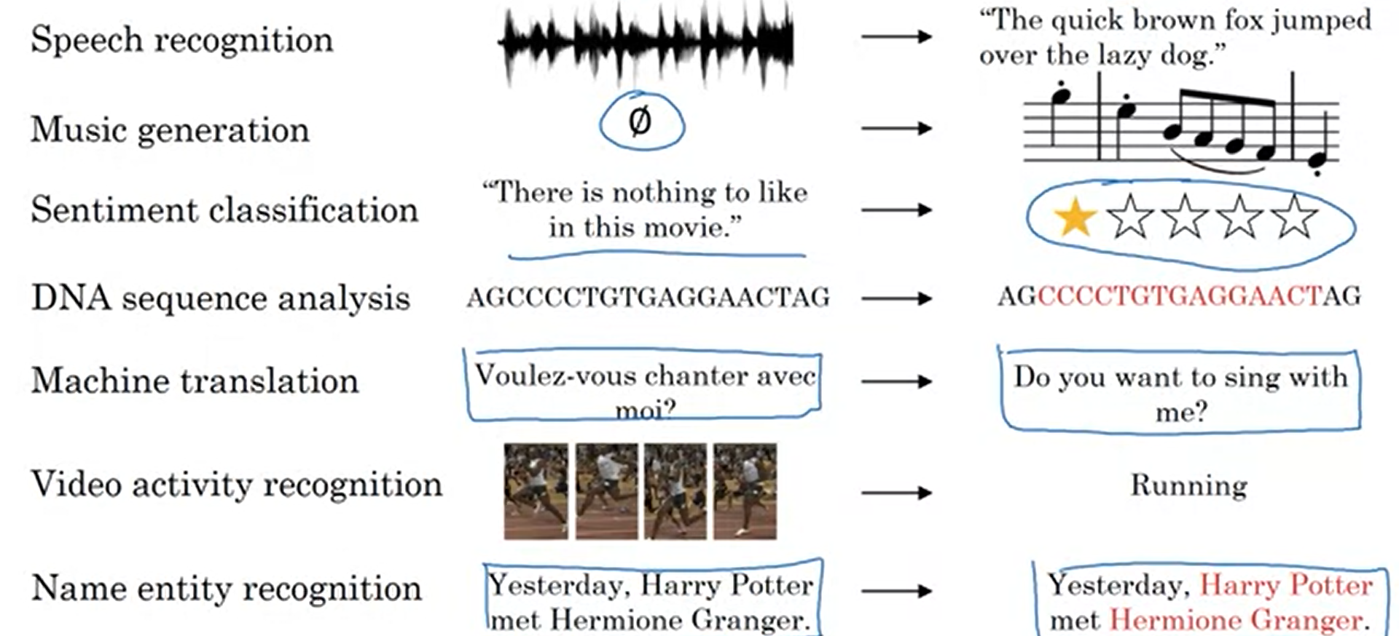
Examples of Sequence data

Slide 44
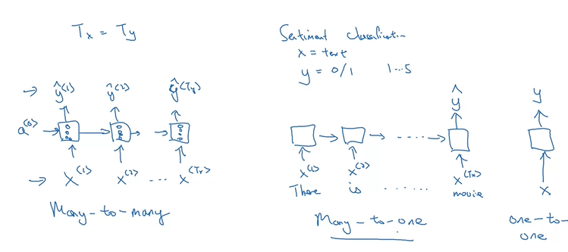
Types of RNN architectures

Slide 45
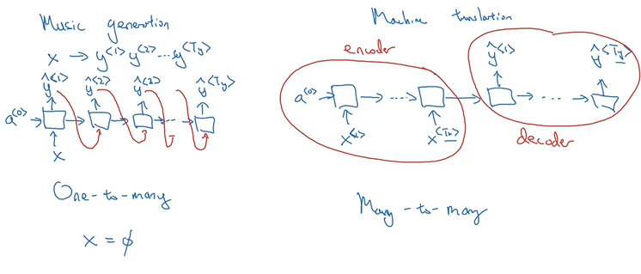
Types of RNNs

Slide 46
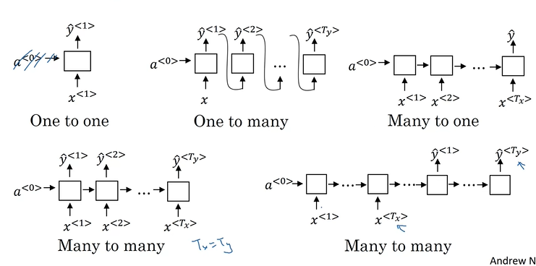
Summary of RNN architectures

Slide 47
Architecture and algorithm of LSTM Networks and Case Study Use RNNs to predict next word in a sentence

Slide 48
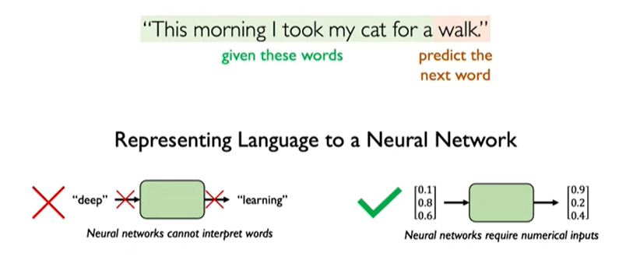
Representing Language

Slide 49
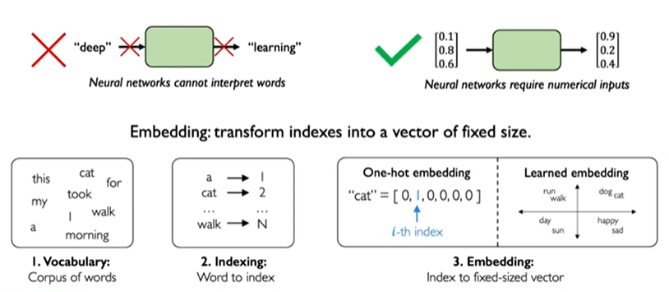
Encoding

Slide 50
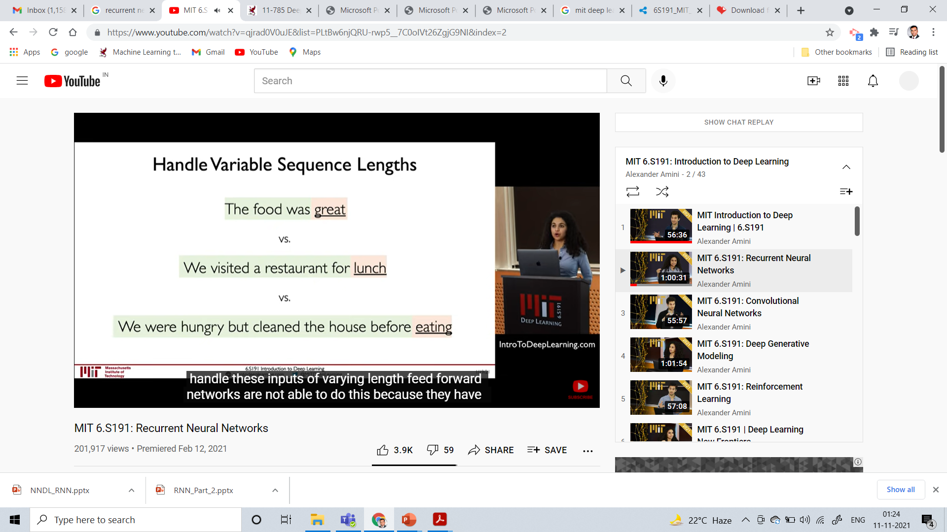


RNNs – Meets Design Criteria of Sequence Modeling

Slide 51

Training RNNs

Slide 52

RNNs: Backpropagation Through Time

Slide 53

Handling Exploding Gradients

Slide 54

Handling Exploding and Vanishing Gradients

Slide 55

The Problem of Long-Term Dependencies

Slide 56



How to handle Long-Term Dependencies ?

Slide 57

Vanilla RNN Gradient Flow
Bengio et al, “Learning long-term dependencies with gradient descent is difficult”, IEEE Transactions on Neural Networks, 1994
Pascanu et al, “On the difficulty of training recurrent neural networks”, ICML 2013
W
tanh
stack
h_{t}
^{h}t-1
x_{t}
Fei-Fei Li & Justin Johnson & Serena Yeung
Fei-Fei Li & Justin Johnson & Serena Yeung Lecture 10 - May 4, 2017

Slide 58
Vanilla RNN Gradient Flow
Bengio et al, “Learning long-term dependencies with gradient descent is difficult”, IEEE Transactions on Neural Networks, 1994
Pascanu et al, “On the difficulty of training recurrent neural networks”, ICML 2013
Backpropagation from h_{t} to h_{t-1} multiplies by W
(actually W
T₎
hh
W
tanh
stack
h_{t}
^{h}t-1
x_{t}
Fei-Fei Li & Justin Johnson & Serena Yeung
Fei-Fei Li & Justin Johnson & Serena Yeung Lecture 10 - May 4, 2017

Slide 59

Vanilla RNN Gradient Flow
Bengio et al, “Learning long-term dependencies with gradient descent is difficult”, IEEE Transactions on Neural Networks, 1994
Pascanu et al, “On the difficulty of training recurrent neural networks”, ICML 2013
h₀
h₁
h₂
h₃
h₄
x₁
x₂
x₃
x₄
Computing gradient of h₀ involves many factors of W
(and repeated tanh)
Fei-Fei Li & Justin Johnson & Serena Yeung
Fei-Fei Li & Justin Johnson & Serena Yeung Lecture 10 - May 4, 2017

Slide 60
Vanilla RNN Gradient Flow
Bengio et al, “Learning long-term dependencies with gradient descent is difficult”, IEEE Transactions on Neural Networks, 1994
Pascanu et al, “On the difficulty of training recurrent neural networks”, ICML 2013
h₀
h₁
h₂
h₃
h₄
x₁
x₂
x₃
x₄
Largest singular value > 1:
Exploding gradients
Computing gradient of h₀ involves many factors of W
(and repeated tanh)
Largest singular value < 1:
Vanishing gradients
Fei-Fei Li & Justin Johnson & Serena Yeung
Fei-Fei Li & Justin Johnson & Serena Yeung Lecture 10 - May 4, 2017

Slide 61

Vanilla RNN Gradient Flow
Bengio et al, “Learning long-term dependencies with gradient descent is difficult”, IEEE Transactions on Neural Networks, 1994
Pascanu et al, “On the difficulty of training recurrent neural networks”, ICML 2013
h₀
h₁
h₂
h₃
h₄
x₁
x₂ x₃
x₄
Largest singular value > 1:
Exploding gradients
Gradient clipping: Scale gradient if its norm is too big
Computing gradient of h₀ involves many factors of W
(and repeated tanh)
Largest singular value < 1:
Vanishing gradients
Fei-Fei Li & Justin Johnson & Serena Yeung
Fei-Fei Li & Justin Johnson & Serena Yeung Lecture 10 - May 4, 2017

Slide 62
Vanilla RNN Gradient Flow
Bengio et al, “Learning long-term dependencies with gradient descent is difficult”, IEEE Transactions on Neural Networks, 1994
Pascanu et al, “On the difficulty of training recurrent neural networks”, ICML 2013
h₀
h₁
h₂
h₃
h₄
x₁
x₂
x₃
x₄
Largest singular value > 1:
Exploding gradients
Computing gradient of h₀ involves many factors of W
(and repeated tanh)
Largest singular value < 1:
Vanishing gradients
Change RNN architecture
Fei-Fei Li & Justin Johnson & Serena Yeung
Fei-Fei Li & Justin Johnson & Serena Yeung Lecture 10 - May 4, 2017

Slide 63


Long Short Term Memory (LSTM)
Vanilla RNN LSTM
Hochreiter and Schmidhuber, “Long Short Term Memory”, Neural Computation 1997

Slide 64
Long Short Term Memory (LSTM)
[Hochreiter et al., 1997]
f: Forget gate, Whether to erase cell
i: Input gate, whether to write to cell
g: Gate gate (?), How much to write to cell
o: Output gate, How much to reveal cell
vector from below (x)
W
x
sigmoid
i
h
sigmoid
f
vector from before (h)
sigmoid
o
tanh
g
4h x 2h
4h
4*h
Fei-Fei Li & Justin Johnson & Serena Yeung
Fei-Fei Li & Justin Johnson & Serena Yeung Lecture 10 - May 4, 2017

Slide 65
Long Short Term Memory (LSTM)
[Hochreiter et al., 1997]
☉
+
c_{t}
^{c}t-1
f
i
W
_{g} ☉
tanh
^{h}t-1
stack
o
☉
h_{t}
x_{t}
Fei-Fei Li & Justin Johnson & Serena Yeung
Fei-Fei Li & Justin Johnson & Serena Yeung Lecture 10 - May 4, 2017

Slide 66
Long Short Term Memory (LSTM): Gradient Flow
[Hochreiter et al., 1997]
Backpropagation from c_{t} to
☉ + c
c_{t-1} only elementwise multiplication by f, no matrix multiply by W
c
t-1
t
f
i
W
_{g} ☉
tanh
^{h}t-1
stack
o
☉
h_{t}
x_{t}
Fei-Fei Li & Justin Johnson & Serena Yeung
Fei-Fei Li & Justin Johnson & Serena Yeung Lecture 10 - May 4, 2017

Slide 67

Long Short Term Memory (LSTM): Gradient Flow
[Hochreiter et al., 1997]
Uninterrupted gradient flow!
c₀ c₁ c₂
c₃
Fei-Fei Li & Justin Johnson & Serena Yeung
67
Fei-Fei Li & Justin Johnson & Serena Yeung Lecture 10 - May 4, 2017

Slide 68
Long Short Term Memory (LSTM): Gradient Flow
[Hochreiter et al., 1997]
Uninterrupted gradient flow!
c₀ c₁ c₂
c₃
Fei-Fei Li & Justin Johnson & Serena Yeung
68
Fei-Fei Li & Justin Johnson & Serena Yeung Lecture 10 - May 4, 2017

Slide 69

Long Short Term Memory (LSTM): Gradient Flow
[Hochreiter et al., 1997]
Uninterrupted gradient flow!
c₀ c₁ c₂
c₃
In between:
Highway Networks
Similar to ResNet!
3x3 conv, 128
3x3 conv, 128
3x3 conv, 128
3x3 conv, 128
3x3 conv, 128
3x3 conv, 128 / 2
3x3 conv, 64
3x3 conv, 64
3x3 conv, 64
3x3 conv, 64
3x3 conv, 64
3x3 conv, 64
Pool
7x7 conv, 64 / 2 Input
Softmax FC 1000
Pool
3x3 conv, 64
3x3 conv, 64
3x3 conv, 64
3x3 conv, 64
3x3 conv, 64
3x3 conv, 64
...
Srivastava et al, “Highway Networks”, ICML DL Workshop 2015
Fei-Fei Li & Justin Johnson & Serena Yeung
69
Fei-Fei Li & Justin Johnson & Serena Yeung Lecture 10 - May 4, 2017

Slide 70


Other RNN Variants
[An Empirical Exploration of Recurrent Network Architectures, Jozefowicz et al., 2015]
GRU [Learning phrase representations using rnn encoder-decoder for statistical machine translation, Cho et al. 2014]
[LSTM: A Search Space Odyssey, Greff et al., 2015]

Slide 71



Gated Recurrent Unit (GRU)
Gated Recurrent Unit which is a modification to the RNN hidden layer that makes it much better capturing long range connections and helps a lot with the vanishing gradient problems.

Slide 72


GRU Unit

Slide 73



Addressing very long range dependencies
The gate is quite easy to set to zero. So when that is the case, then this updated equation and subsetting c<t> equals c<t-1> . So this is very good at maintaining the value for the cell.
As gamma can be so close to zero, can be 0.000001 or even smaller than that, it doesn't suffer from much of a vanishing gradient problem.
If gamma so close to zero this becomes essentially c<t> equals c<t-1> and the value of c<t> is maintained pretty much exactly even across many time-steps.
So this can help significantly with the vanishing gradient problem and therefore allow a neural network to go on even very long range dependencies, such as a cat and was related even if they're separated by a lot of words in the middle.

Slide 74
Application
Language Model & Sequence Model Generation

Slide 75

What is language modeling?

Slide 76

Language modeling with an RNN

Slide 77

RNN Model

Slide 78

Recurrent Neural Network
Convolutional Neural Network
Fei-Fei Li & Justin Johnson & Serena Yeung
Fei-Fei Li & Justin Johnson & Serena Yeung Lecture 10 - May 4, 2017

Slide 79

test image
This image is CC0 public domain

Slide 80

test image

Slide 81
test image
X

Slide 82
test image
x0
<STA RT>
<START>

Slide 83

test image
y0
before:
h = tanh(Wxh * x + Whh * h)
h0
Wih
now:
h = tanh(Wxh * x + Whh * h + Wih * v)
x0
<STA RT>
v
<START>

Slide 84
test image
y0
h0
sample!
x0
<STA RT>
straw
<START>

Slide 85
test image
y0
y1
h0
h1
x0
<STA RT>
straw
<START>

Slide 86
test image
y0
y1
h0
h1
sample!
x0
<STA RT>
straw
hat
<START>

Slide 87
test image
y0
y1
y2
h0
h1
h2
x0
<STA RT>
straw
hat
<START>

Slide 88
test image
y0
y1
y2
sample
<END> token
=> finish.
h0
h1
h2
x0
<STA RT>
straw
hat
<START>

Slide 89








Image Captioning: Example Results
Captions generated using neuraltalk2 All images are CC0 Public domain:
cat suitcase, cat tree, dog, bear,
surfers, tennis, giraffe, motorcycle
A cat sitting on a suitcase on the floor
A cat is sitting on a tree branch
A dog is running in the grass with a frisbee
A white teddy bear sitting in the grass
Two people walking on the beach with surfboards
A tennis player in action on the court
Two giraffes standing in a grassy field
A man riding a dirt bike on a dirt track
Fei-Fei Li & Justin Johnson & Serena Yeung
Fei-Fei Li & Justin Johnson & Serena Yeung Lecture 10 - May 4, 2017

Slide 90





Image Captioning: Failure Cases
Captions generated using neuraltalk2 All images are CC0 Public domain: fur coat, handstand, spider web, baseball
A bird is perched on a tree branch
A woman is holding a cat in her hand
A man in a baseball uniform throwing a ball
A woman standing on a beach holding a surfboard
A person holding a computer mouse on a desk
Fei-Fei Li & Justin Johnson & Serena Yeung
Fei-Fei Li & Justin Johnson & Serena Yeung Lecture 10 - May 4, 2017

Slide 91

Image Captioning with Attention
RNN focuses its attention at a different spatial location when generating each word
Xu et al, “Show, Attend, and Tell: Neural Image Caption Generation with Visual Attention”, ICML 2015
Figure copyright Kelvin Xu, Jimmy Lei Ba, Jamie Kiros, Kyunghyun Cho, Aaron Courville, Ruslan Salakhutdinov, Richard S. Zemel, and Yoshua Benchio, 2015. Reproduced with permission.

Slide 92


Image Captioning with Attention
CNN
h0
Features: L x D
Image: H x W x 3
Xu et al, “Show, Attend and Tell: Neural
Image Caption Generation with Visual Attention”, ICML 2015
Fei-Fei Li & Justin Johnson & Serena Yeung
Fei-Fei Li & Justin Johnson & Serena Yeung Lecture 10 - May 4, 2017

Slide 93
Image Captioning with Attention
Distribution over L locations
a1
CNN
h0
Features: L x D
Image: H x W x 3
Xu et al, “Show, Attend and Tell: Neural
Image Caption Generation with Visual Attention”, ICML 2015
Fei-Fei Li & Justin Johnson & Serena Yeung
Fei-Fei Li & Justin Johnson & Serena Yeung Lecture 10 - May 4, 2017

Slide 94

Image Captioning with Attention
Distribution over L locations
a1
CNN
h0
Features: L x D
Image: H x W x 3
Weighted
z1
features: D
Weighted combination of features
Xu et al, “Show, Attend and Tell: Neural
Image Caption Generation with Visual Attention”, ICML 2015
Fei-Fei Li & Justin Johnson & Serena Yeung
Fei-Fei Li & Justin Johnson & Serena Yeung Lecture 10 - May 4, 2017

Slide 95
Image Captioning with Attention
Distribution over L locations
a1
CNN
h0
h1
Features: L x D
Image: H x W x 3
Weighted
z1
y1
features: D
Weighted combination of features
Xu et al, “Show, Attend and Tell: Neural
Image Caption Generation with Visual Attention”, ICML 2015
First word
Fei-Fei Li & Justin Johnson & Serena Yeung
Fei-Fei Li & Justin Johnson & Serena Yeung Lecture 10 - May 4, 2017

Slide 96
Image Captioning with Attention
Distribution over L locations
Distribution over vocab
a1
a2
d1
CNN
h0
h1
Features: L x D
Image: H x W x 3
Weighted
z1
y1
features: D
Weighted combination of features
Xu et al, “Show, Attend and Tell: Neural
Image Caption Generation with Visual Attention”, ICML 2015
First word
Fei-Fei Li & Justin Johnson & Serena Yeung
Fei-Fei Li & Justin Johnson & Serena Yeung Lecture 10 - May 4, 2017

Slide 97
Image Captioning with Attention
Distribution over L locations
Distribution over vocab
a1
a2
d1
CNN
h0
h1
h2
Features: L x D
Image: H x W x 3
Weighted
z1
y1
z2
y2
features: D
Weighted combination of features
Xu et al, “Show, Attend and Tell: Neural
Image Caption Generation with Visual Attention”, ICML 2015
First word
Fei-Fei Li & Justin Johnson & Serena Yeung
Fei-Fei Li & Justin Johnson & Serena Yeung Lecture 10 - May 4, 2017

Slide 98
Image Captioning with Attention
Distribution over L locations
Distribution over vocab
a1
a2
d1
a3
d2
CNN
h0
h1
h2
Features: L x D
Image: H x W x 3
Weighted
z1
y1
z2
y2
features: D
Weighted combination of features
Xu et al, “Show, Attend and Tell: Neural
Image Caption Generation with Visual Attention”, ICML 2015
First word
Fei-Fei Li & Justin Johnson & Serena Yeung
Fei-Fei Li & Justin Johnson & Serena Yeung Lecture 10 - May 4, 2017

Slide 99

Image Captioning with Attention
Soft attention
Hard attention
Xu et al, “Show, Attend, and Tell: Neural Image Caption Generation with Visual Attention”, ICML 2015
Figure copyright Kelvin Xu, Jimmy Lei Ba, Jamie Kiros, Kyunghyun Cho, Aaron Courville, Ruslan Salakhutdinov, Richard S. Zemel, and Yoshua Benchio, 2015. Reproduced with permission.
Fei-Fei Li & Justin Johnson & Serena Yeung
Fei-Fei Li & Justin Johnson & Serena Yeung Lecture 10 - May 4, 2017

Slide 100

Image Captioning with Attention
Xu et al, “Show, Attend, and Tell: Neural Image Caption Generation with Visual Attention”, ICML 2015
Figure copyright Kelvin Xu, Jimmy Lei Ba, Jamie Kiros, Kyunghyun Cho, Aaron Courville, Ruslan Salakhutdinov, Richard S. Zemel, and Yoshua Benchio, 2015. Reproduced with permission.
Fei-Fei Li & Justin Johnson & Serena Yeung
Fei-Fei Li & Justin Johnson & Serena Yeung Lecture 10 - May 4, 2017

Slide 101

Visual Question Answering
Agrawal et al, “VQA: Visual Question Answering”, ICCV 2015
Zhu et al, “Visual 7W: Grounded Question Answering in Images”, CVPR 2016
Figure from Zhu et al, copyright IEEE 2016. Reproduced for educational purposes.
Fei-Fei Li & Justin Johnson & Serena Yeung
Fei-Fei Li & Justin Johnson & Serena Yeung Lecture 10 - May 4, 2017

Slide 102



Visual Question Answering: RNNs with Attention
Zhu et al, “Visual 7W: Grounded Question Answering in Images”, CVPR 2016
Figures from Zhu et al, copyright IEEE 2016. Reproduced for educational purposes.
Fei-Fei Li & Justin Johnson & Serena Yeung
88
Fei-Fei Li & Justin Johnson & Serena Yeung Lecture 10 - May 4, 2017

Slide 103



Multilayer RNNs
LSTM:
depth
time
Fei-Fei Li & Justin Johnson & Serena Yeung
Fei-Fei Li & Justin Johnson & Serena Yeung Lecture 10 - May 4, 2017

Slide 104


Acknowledgements
The content of this presentation is based on the lecture on Recurrent Neural Networks by Ava Soleimany, MIT Introduction to Deep Learning 6.S191.
I thank Prof. Andrew Ng for providing the lecture contents for teaching through coursera.
The content in this presentation is from the lectures of Andrew Ng.

Slide 105
Further Study..
https://stanford.edu/~shervine/teaching/cs-230/cheatsheet-recurrent-neural-networks
http://web.stanford.edu/class/cs224n/slides/cs224n-2020-lecture07-fancy-rnn.pdf
http://cs231n.stanford.edu/slides/2017/cs231n_2017_lecture10.pdf
https://direct.mit.edu/neco/article/31/7/1235/8500/A-Review-of-Recurrent-Neural-Networks-LSTM-Cells
https://github.com/Kulbear/deep-learning-coursera/blob/master/Sequence%20Models/Building%20a%20Recurrent%20Neural%20Network%20-%20Step%20by%20Step%20-%20v2.ipynb

Slide 106
Flip – Class Room Teaching
On 24 Nov 2021:
Topic: Demo on CNNs by Mr. P. Anurag Varma (Reg : 006)
On 1 Dec 2021:
Topic: Tutorial on “ Keras for Deep Learning” by Mr. N. Tarun Chandra (Reg: 54)
Topic: Tutorial on “PyTorch for Deep Learning”, by Mr. B .V. Siva Kumar (Reg: 57)
On 3 Dec 2021:
Topic: Comparative Study on “ Various CNN model on MNIST Data” by Mr. N. Bhuvanesh Reddy (Reg 16)

Slide 107
Attendance : 12 Nov 2021 9:40 to 10:40 (NNDL)
Present
A Sec: 5, 6, 7, 8, 9, 14, 16, 18, 23, 24, 26, 30, 33, 34, 37, 38, 40, 42, 43, 44, 46, 47, 48, 49, 50, 54, 56, 57, 58, 304.
B Sec: 61, 62, 63, 64, 66, 67, 68, 70, 71, 73, 76, 78, 80, 81, 88, 96, 110, 111, 113, 115, 116, 117, 120,

Slide 108
Attendance: 24 Nov 2021(NNDL 10:40 to 11:40)
A Sec: 5, 6, 7, 8, 13, 14, 16, 18, 20, 23, 24, 26, 30, 33, 34, 35, 37, 38, 42, 43, 44, 46, 47, 48, 49, 50, 54, 56, 57, 60, 304
B Sec: 61, 62,63, 64, 66, 67, 68, 70, 71, 73, 74, 76, 78, 80, 81, 83, 88, 94, 96, 110, 111, 113, 115, 116, 117, 118, 120, 308,

Slide 109
Attendance: 25 Nov 2021(NNDL 1:20 to 2:20)
Present:
A Sec: 5, 6, 7, 8, 13, 14, 16, 18, 20, 23, 24, 26, 33, 30, 34, 35, 37, 38, 42, 43, 44, 46, 47, 48, 49, 50, 54, 56, 57, 58, 60
B Sec: 63, 66, 67, 68, 70, 73, 76, 78, 80, 83, 88, 94, 96, 110, 112, 113, 115, 116, 118, 120, 308

Slide 110
NNDL (30 Nov 2021) [3:20PM to 4:20PM]
A Sec: 5, 8, 13, 14, 16, 20, 23, 24, 26, 30, 33, 34, 37, 38, 40, 42, 43, 46, 47, 48, 49, 54, 56, 58, 304
B Sec: 61, 62, 63, 64, 66, 68, 70, 73, 74, 76, 80, 81, 83, 88, 94, 96, 111, 113, 116, 118, 308

Slide 111
NNDL (1 Dec 2021) [10:40AM to 11:40AM]
A Sec: 5, 8, 14, 16, 20, 23, 24, 26, 30, 33, 34, 37, 38, 40, 42, 43, 46, 47, 48, 49, 54, 56, 58, 304, (13)
B Sec: 61,62, 63, 64, 66, 68, 70, 73, 74, 78, 80, 81, 83, 88, 94, 96, 110, 111, 112, 113, 115, 116, 118, 308

Slide 112
NNDL (2 Dec 2021) [1:20PM to 2:20PM]
A Sec: 5, 6, 7, 8, 13, 14, 16, 18, 20, 23, 24, 26, 30, 33, 34, 35, 37, 38, 40, 42, 43, 44, 46, 47, 48, 49, 50, 54, 56, 57, 58, 60, 304
B Sec: 61, 63, 66, 68, 70, 73, 76, 78, 81, 83, 88, 94, 96, 110, 111, 112, 113, 115, 116, 117, 118, 120, 308

Slide 113
NNDL (8 Dec 2021) [1:20PM to 2:20PM]
A Sec: 7, 9, 14, 16, 18, 20, 24, 37, 40, 43, 46, 49, 50, 57, 60
B Sec: 63, 66, 67, 68, 71, 73, 78, 80, 81, 83, 94, 96, 110, 111, 112, 115, 118

Slide 114
NNDL (10 Dec 2021) [9:40AM to 10:40PM]
A Sec: 5, 6, 7, 8, 13, 14, 16, 18, 23, 24, 33, 34, 35, 37, 38, 40, 42, 44, 46, 47, 49, 50, 54, 56, 57, 58, 60
B Sec: 61, 62, 63, 64, 66, 68, 70, 71, 73, 74, 76, 78, 80, 81, 83, 88, 94, 96, 110, 113, 116, 117, 118, 120, 308

Slide 115
Questions?
You can write your questions
hitendrasarma@ieee.org
hitendrasarma@staff.vce.ac.in

